Slide 1
Direct lake and Power BI

Slide 2
Capabilities
Capabilities of Microsoft fabric are
Role-specific workloads: Customized solutions for various roles within an organization, providing each user with the necessary tools.
OneLake: A unified data lake that simplifies data management and access.
Copilot support: AI-driven features that assist users by providing intelligent suggestions and automating tasks.
Integration with Microsoft 365: Seamless integration with Microsoft 365 tools, enhancing collaboration and productivity across the organization.
Azure AI Foundry: Utilizes Azure AI Foundry for advanced AI and machine learning capabilities, enabling users to build and deploy AI models efficiently.
Unified data management: Centralized data discovery that simplifies governance, sharing, and access.

Slide 3
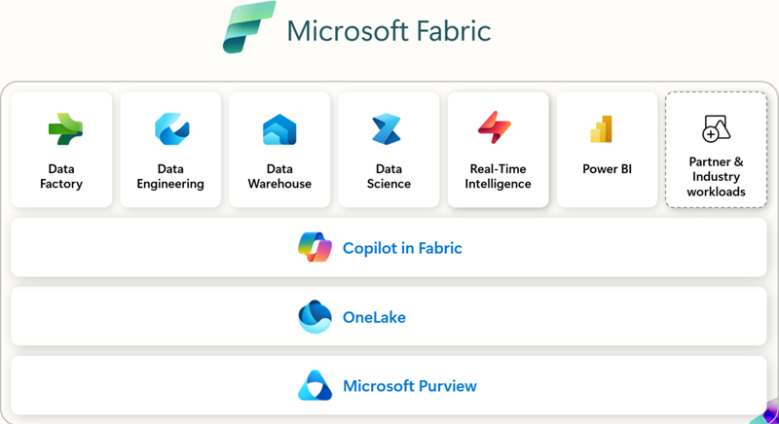

Slide 4
Components of Microsoft Fabric
components of Microsoft fabric

Slide 5
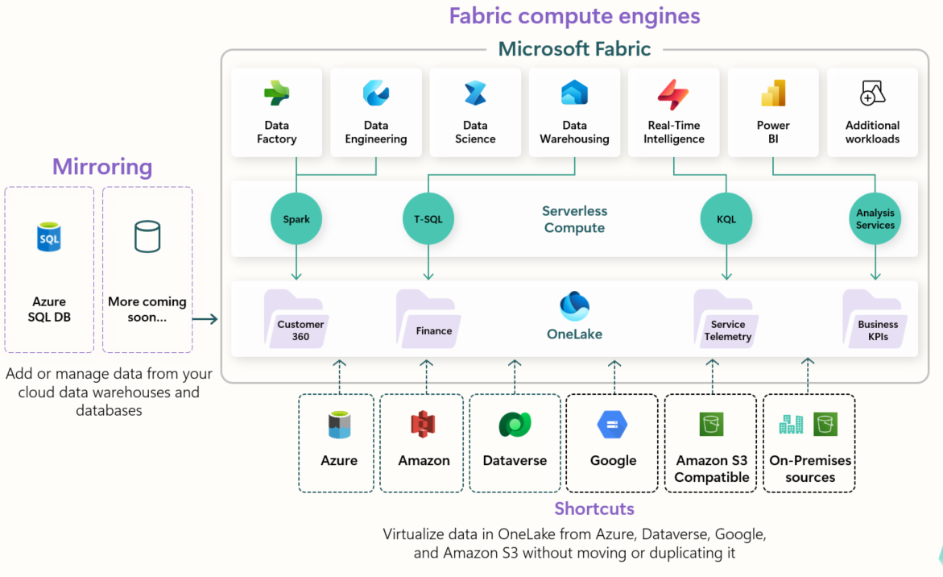

Slide 6
Evaluation of workflow
Microsoft Fabric transforms the analytics development process by unifying tools into a SaaS platform, allowing flexibility for different roles to perform necessary skills without duplicating efforts.
Data engineers can now ingest, transform, and load large amounts of data into OneLake and present it in whichever data store makes most sense. Data loading patterns are simplified using pipelines and architectures, such as medallion, can be easily configured using workspaces.
Data analysts gain greater context and streamline processes, transforming data upstream with Data Factory and connecting with data more directly using Direct Lake mode.
Data scientists Integrate native data science techniques more easily and use Power BI's interactive reporting to provide data-informed insights.
Analytics engineers bridge the gap between data engineering and data analysis by curating data store assets, ensuring data quality, and enabling self-service analytics.
Low-to-no-code users and citizen developers can now discover curated data through the OneLake hub, and further process and analyze it to suit their needs without being dependent on data engineers or duplicating data.

Slide 7
How to Start
Workspaces are collaborative environments where you create and manage items like lakehouses, warehouses, and reports. All data is stored in OneLake, and is accessed through workspaces. Items are displayed in a list or lineage view, which is a visual representation of the dependency between items.
In the Workspace settings, you can configure the license type to use Fabric features. There are several other settings you can configure in this area, some of which include:
OneDrive access for the workspace
Azure Data Lake Gen2 Storage connection
Integration with Git for version control
Spark workload settings

Slide 8
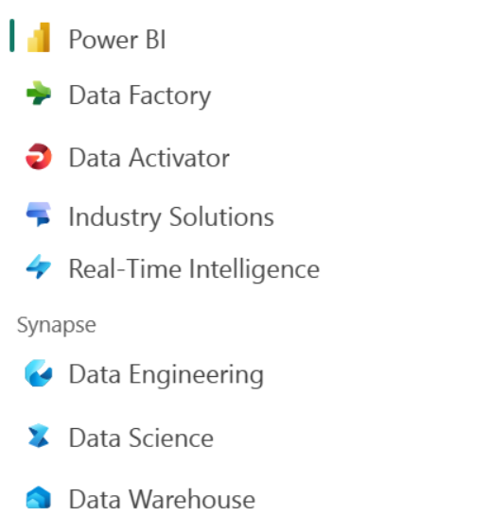
Create Fabric items
You might notice that Fabric workloads look similar to other Microsoft data offerings. Fabric is built on Power BI and Azure Data Lake Storage, and includes capabilities from Azure Synapse Analytics, Azure Data Factory, Azure Databricks, and Azure Machine Learning. What makes Fabric unique is that it brings these capabilities together in a single, SaaS integrated experience without the need for access to Azure resources.

Slide 9
OVERVIEW OF
MICROSOFT
FABRIC

